Slide 1
Steering the Future: The Dawn of Automated Drives
Lakshmanan.M
QA
© 2024 all rights reserved

Slide 2

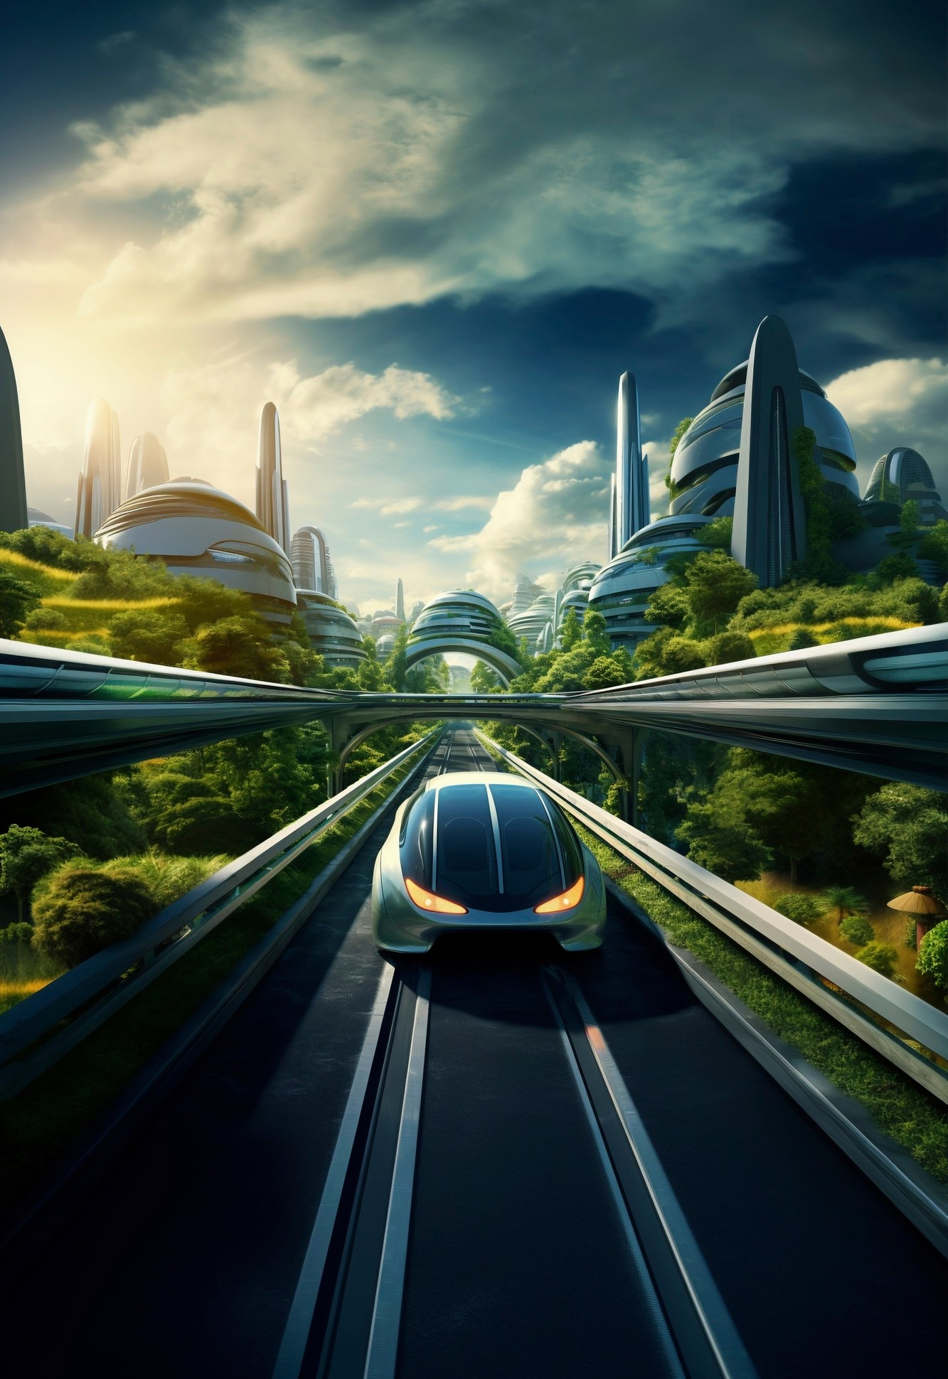
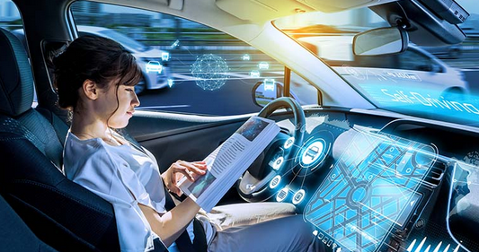
Introduction to Automated Drives
Automated drives are revolutionizing the way we think about transportation. This presentation explores the technological advancements, benefits, and challenges of this exciting evolution in driving. Buckle up as we steer into the future of mobility!
What Are Automated Drives?
Automated drives refer to vehicles equipped with technology that allows them to navigate and drive without human intervention. These systems rely on sensors, cameras, and algorithms to interpret their environment and make driving decisions.

Slide 3



The Technology Behind It
At the heart of automated driving are advanced technologies like machine learning, computer vision, and LiDAR. These innovations enable vehicles to perceive their surroundings, recognize obstacles, and react in real-time to ensure safe travel.
Benefits of Automated Drives
Automated drives promise numerous benefits, including reduced traffic accidents, improved fuel efficiency, and enhanced mobility for those unable to drive. These innovations can transform urban landscapes and create a more sustainable future.
© 2024 all rights reserved

Slide 4
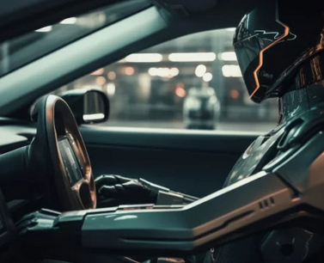
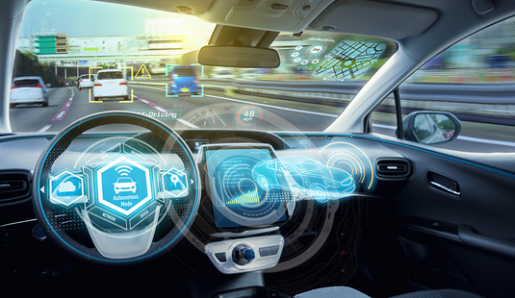
Regulatory Landscape
Regulations surrounding automated driving vary globally, impacting the pace of development. Policymakers must balance innovation with safety and responsibility, creating frameworks that support the growth of this transformative technology.
As we navigate the complexities of automated drives, it's essential to remain adaptable and innovative. The collaboration between technology, government, and society will shape the future of our roads and transportation systems.
Public Perception
The success of automated drives hinges on public perception. Education and outreach are crucial to dispel myths and build trust in this technology. Engaging communities is essential for fostering acceptance and understanding.
© 2024 all rights reserved

Slide 5

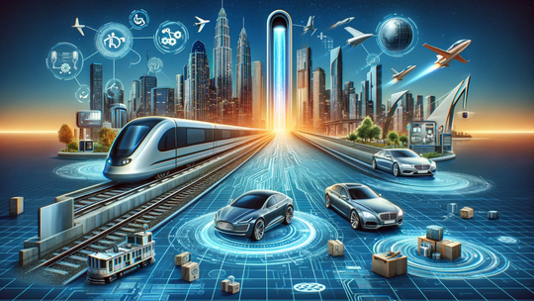
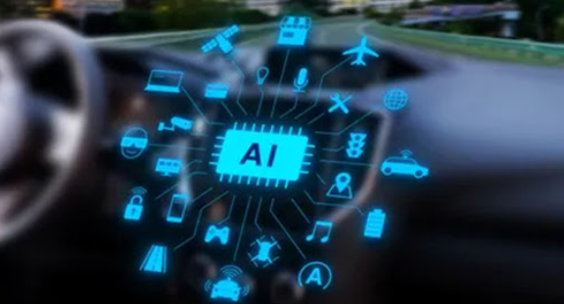
Future of Transportation
The future of transportation is intertwined with automated drives. As technology evolves, we can expect smarter cities, reduced congestion, and a shift towards shared mobility solutions that benefit everyone.
The Role of AI
Artificial Intelligence plays a pivotal role in the development of automated drives. AI systems analyze vast amounts of data to improve decision-making, enhance safety, and provide a seamless driving experience for users.
© 2024 all rights reserved

Slide 6
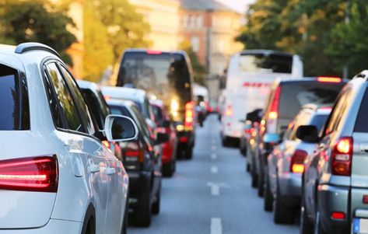
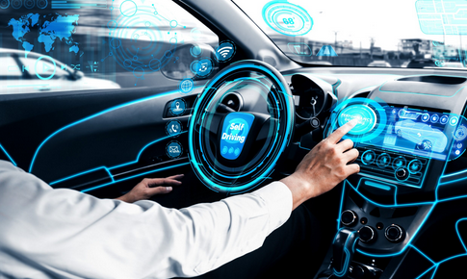
Challenges Ahead
Despite the potential, automated drives face significant challenges. Issues related to regulation, public acceptance, and cybersecurity must be addressed to ensure safe and widespread adoption of this technology.
Conclusion Embracing Change
In conclusion, automated drives represent a significant leap towards a safer, more efficient future. By embracing this change and addressing the challenges ahead, we can steer toward a world where mobility is accessible and sustainable for all.
© 2024 all rights reserved

Slide 7

© 2024 all rights reserved

